Slide 1
GPF (Green Pellet Fuel)
BUS1003.2 – Entrepreneurship and Innovation
Ferhat YÜKSEL | EEE | 150719540
Tolga TAŞDEMİR | BIOE | 150822032
Ahmet Tuğrul Berber | EEE | 150721046
İrem Korkmaz | BIOE | 150822030

Slide 2
CONTENT
Company Name And Logo
Problem Definition
Problem Solution
Oportunity And Target Market
Technology
Competition
Marketing And Sales
Manangment Team
Financial Projections
5-year Investment Costs
Current Status
SWOT analysis
Business Canvas Model
Business Model Design
Financing Sought
Conclusion

Slide 3
PROBLEM– GPF
The problem we think about and find a solution to is increasing plant waste and non-renewable energy resources used. These pollute the environment, increase carbon emissions, harm nature and disrupt the ecosystem.
Waste plants that farmers try to destroy by burning after harvest are used as waste plants, coal and wood that people use for heating or cooking things. These pollution problems basically cause permanent damage to nature and humanity.

Slide 4

SOLUTİON
While looking for a project topic in our senior year at university, we started to examine the problems experienced in the energy sector. When we started researching the issues, we realized that people were using too much non-renewable energy. For this reason, we thought of producing pellet fuel as an alternative to wood and coal, which are non-renewable energy sources, and planned to use vegetable waste while producing it. In this way, people will move away from using coal and wood, and at the same time, we will save nature from vegetable waste. In addition, the name of the brand we established consists of the initials of green pellet energy.

Slide 5

GPF COMPANY LOGO

Slide 6
OPPORTUNITY AND TARGET MARKET
Heating and energy production sectors: Pellet fuels can be preferred to meet the heating needs in homes and commercial areas. It can also be used for energy production.
Industrial facilities and businesses: Large-scale businesses or industrial facilities can turn to pellet fuels to meet their energy needs.
Industrial facilities and businesses: Large-scale businesses or industrial facilities can turn to pellet fuels to meet their energy needs.
Renewable energy incentives and environmental policies: In some countries and regions, providing incentives for renewable energy sources or supporting environmental policies may encourage the use of pellet fuels produced from vegetable waste.
Our target audience will be those who can use these fuels and those who see the environmental benefits of these fuels. We can target these groups that want to meet their energy needs by offering pellet fuels that comply with quality standards, are environmentally friendly and economically competitive. We can also develop strategies by taking into account energy policies and incentives at local and national levels.

Slide 7

TECHNOLOGY
Raw material preparation: The raw material to be used in pellet production is first dried to reduce its moisture content below 10%. Then, it is pulverized by grinding.
Pelletizing: The powdered raw material is compressed into pellets under high pressure. This process is usually done in rotary or extruder type presses.
Packaging: Pellets are usually packaged in 25 kg bags and offered for sale.

Slide 8
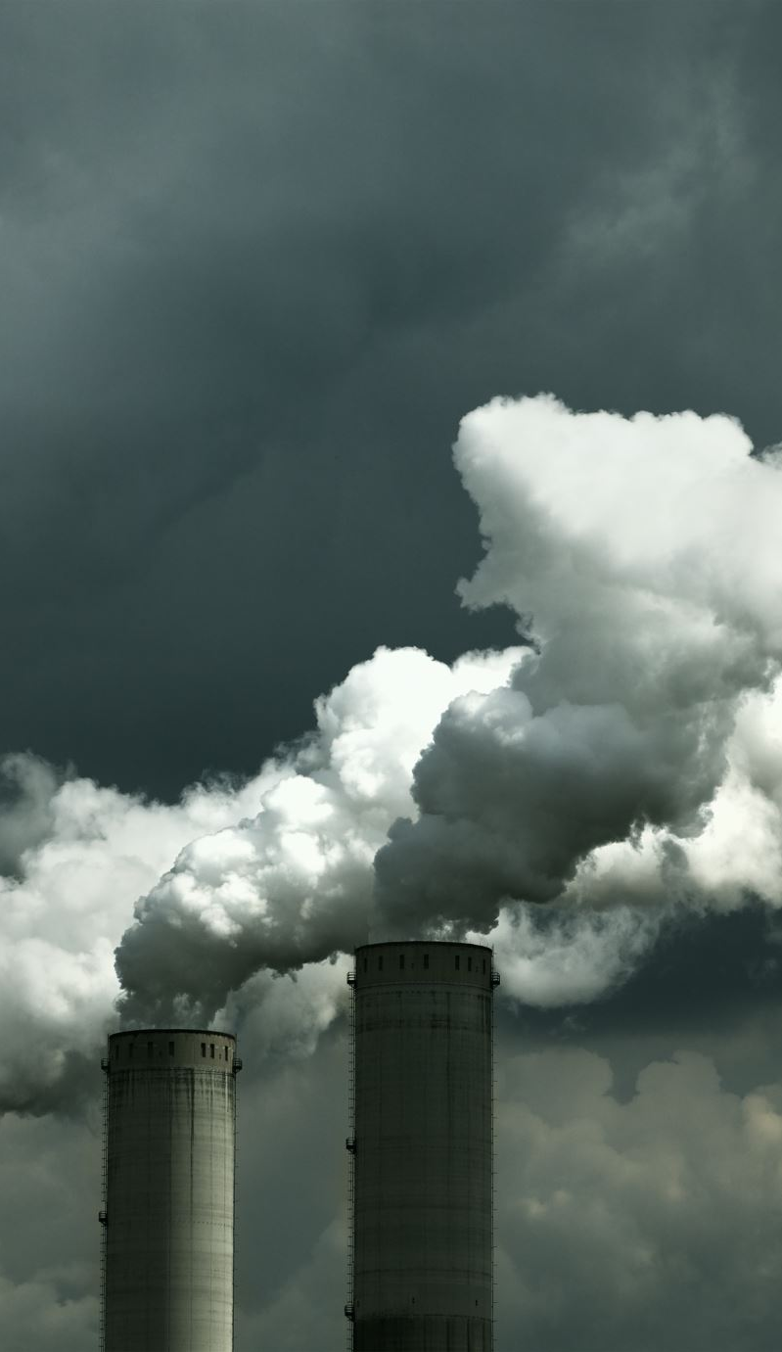
COMPATITION
Pellet fuel is a fuel used in heating, electricity generation and industrial plants. Therefore, it is in competition with other fuels.
The most important competitive advantages of pellet fuel are:
High energy density: The energy density of pellet fuel is higher than other solid fuels such as coal and wood. Therefore, storage and transportation costs are lower.
Clean combustion: Emissions from the combustion of pellet fuel are lower than other solid fuels such as coal and wood. Therefore, it is an environmentally friendly fuel.
Automatic combustion: Pellet fuel can be burned automatically. Therefore, it is easy and safe to use.

Slide 9
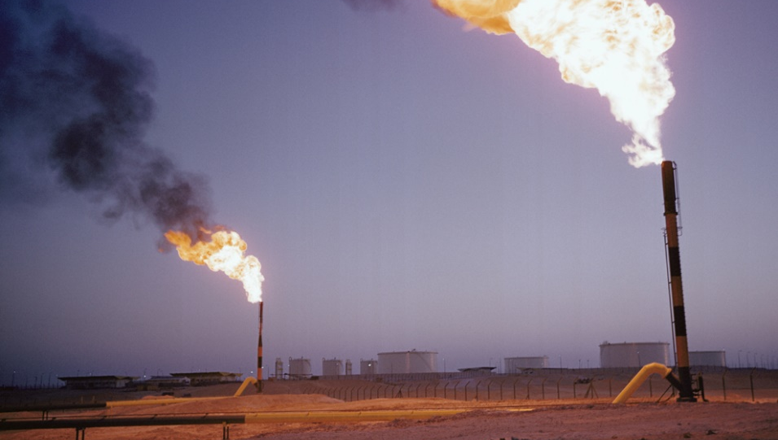
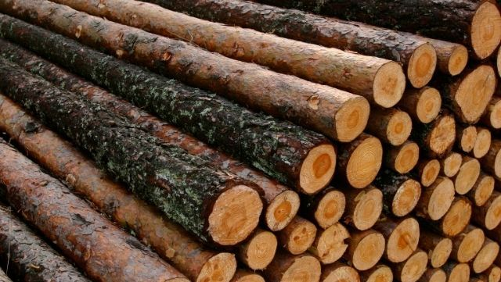
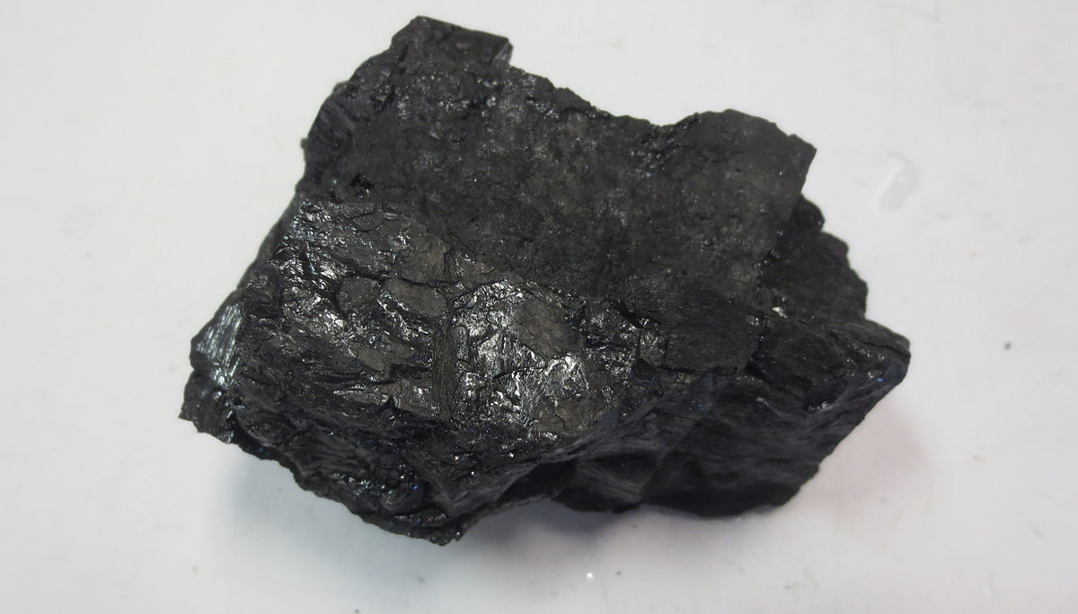
COMPATITION
The main competitors of pellet fuel are:
Coal: Coal has a lower energy density than pellet fuel, but is more widely used. Therefore, it has a lower initial cost than pellet fuel.
Wood: Wood has a lower energy density than pellet fuel, but is cheaper. Therefore, it has a lower operating cost than pellet fuel.
Natural gas: Natural gas has a higher energy density than pellet fuel and provides cleaner combustion. However, it has a higher operating cost.

Slide 10
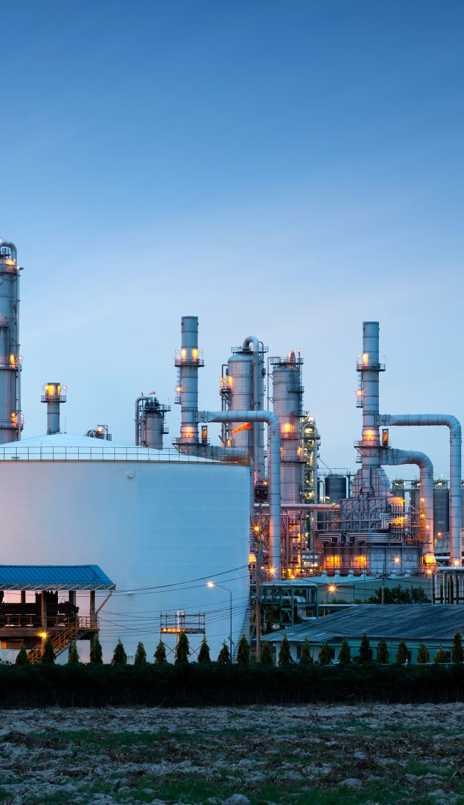
MARKETING AND SALES
Marketing strategies:
Identifying the target audience: Marketing strategies for pellet fuel must first correctly identify the target audience. The target audience is the people who will benefit from the properties of pellet fuel.
Emphasizing the benefits of pellet fuel: Marketing activities should emphasize the benefits of pellet fuel. These benefits include:
High energy density: The energy density of pellet fuel is higher than other solid fuels such as coal and wood. Therefore, storage and transportation costs are lower.
Clean combustion: Emissions from the combustion of pellet fuel are lower than other solid fuels such as coal and wood. Therefore, it is an environmentally friendly fuel.
Automatic combustion: Pellet fuel can be burned automatically. Therefore, it is easy and safe to use.

Slide 11

MARKETING AND SALES
Sales strategies:
The right distribution network: A proper distribution network should be established for the sale of pellet fuel. The distribution network should be such that pellet fuel can easily reach the target audience.
Ensuring customer satisfaction: In pellet fuel sales, it is important to ensure customer satisfaction. For this purpose, after-sales services can be offered.
Competitive pricing: The pricing of pellet fuel should be competitive. This will enable pellet fuel to compete with other fuels.

Slide 12

Management Team
Strategic Planning: Developing and implementing long-term strategies for the growth and sustainability of the pellet fuel startup.
Partnership Management: Building and nurturing strategic partnerships with suppliers, distributors, and other stakeholders to strengthen the pellet fuel supply chain.
Financial Management: Responsible for budgeting, financial planning, and resource allocation to sustain the financial health of the pellet fuel startup.
Customer Relations: Cultivating strong relationships with customers, gathering feedback, and addressing concerns to enhance overall satisfaction.

Slide 13

Financial Projections
Investment Costs:
Construction of the production facility and equipment purchase.
Costs for the procurement and storage of raw materials.
Employee salaries and training costs.
Risk Factors:
Potential risks that may affect the business and measures taken against these risks.
Market fluctuations and other industry factors.
Future Growth and Expansion Plans:
Business's potential for future growth and expansion plans.
Strategies for entering new markets or introducing new products.

Slide 14

5-years Investment Cost
Cost of Raw Materials:
Procurement and cost analysis of raw materials (wood waste, agricultural residues, etc.).
Agreements with suppliers and cost advantages.
Land and Infrastructure:
Acquire or lease land suitable for your pellet production facility.
Land purchase or lease costs, construction costs, and equipment costs.
Equipment and Machinery:
Investimg in pellet production equipment such as pellet mills, dryers, grinders, and packaging machinery.
Consider both new and used equipment options.
Quality Control and Testing:
Implementing quality control measures to ensure the consistency and quality of your pellet fuel.
Investing in testing equipment and procedures to meet industry standards.

Slide 15
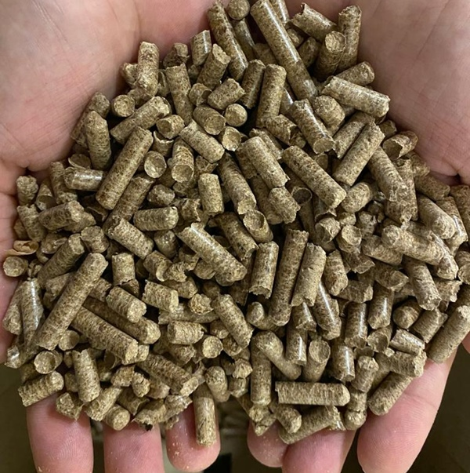
Current Status
Increasing Market Interest:
The growing demand for sustainable energy and environmental concerns creates a favorable atmosphere for pellet fuel projects.
A new startup can benefit from this expanding market.
Environmental Regulations and Certifications:
Compliance with environmental standards and obtaining sustainability certifications is essential in various countries.
In Turkiye, Companies producing pellets must also obtain a Trademark Registration Certificate; They must also prepare the Material Safety Data Sheet report regarding the pellet produced.
Technological Capabilities:
Advances in pellet production technologies allow new entrepreneurs to produce more efficiently and competitively.

Slide 16
SWOT Analysis
Strengths | Weaknesses | Opportunities | Threats
Project management | Financial support | Less competitors | New competitors
Cost reduction | Transportation cost | Regulations and standarts | Economical crisis
Green energy | First investment | Solving environmental problem | Less raw materials
Suistainable energy | Low market | Circular economy | Natural disaster
Generate new job | R&D | Technological development | Supply new materials
Easy storage | Brand reputation | Environmental trend | Regulation

Slide 17
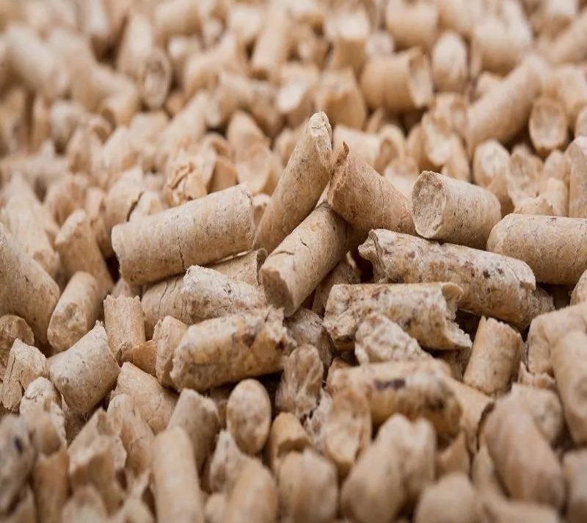
Business Canvas Model
1-Key Partners:
Transport companies
Salesman
Herbal waste collection centers
2-Key Activities:
Producing
Transformation
Packaging
3-Key Resources:
Wood
Agricultural residues
Herbal waste

Slide 18
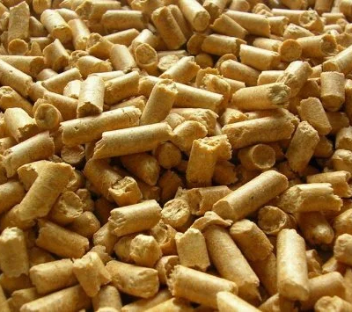
Business Canvas Model
4-Value Proposition:
Can be preffered because its combustion efficiency
Offers to eco-friendly people
5-Customer Relationships:
Call center
Feedback services
Social media channel
6-Channel:
Website
Brochure
Billboards

Slide 19
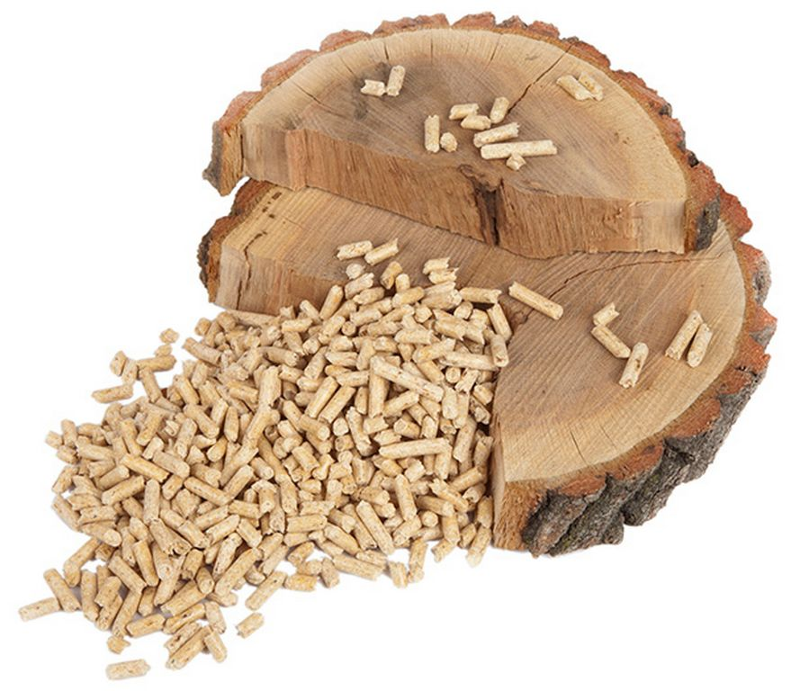
Business Canvas Model
7-Customer Segment:
Eco-friendly people
Government
People who want high energy at low cost
8-Cost Structure:
Employee’s salary
Raw material production fee
Equipments
9-Revenue:
Website
Government
Contracted construction market

Slide 20
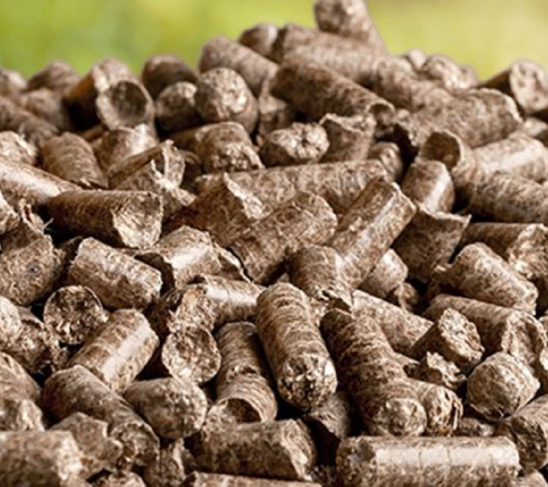
Business Canvas Model
10-Social and Environmental Costs:
Carbon foot print(transporting)
Efficiency tests
Quality control centers
11-Social and Environmental Benefits:
Circle economy
Zero-waste
Suistainable energy
Decreasing residues
Storage is easier than other fuels
Preventing the cunsumption of fossil fuels

Slide 21
Business Model Design
Test
Production
Prototype
Design
And
Product
Marketing
Contact company
Meeting
Government
Eco friendly people
Investor
Revenue and Sales
Customer
Raw Materials
R&D
Contact stores
Feedback
Online stores
After contect revenue
Development
Training
Maintance
After Sales service

Slide 22

Financing Sought
Use of Funds:
The primary uses of the financing include the establishment of the production facility, equipment purchases, raw material procurement, and the implementation of marketing strategies.
Production Facility Setup:
The financing will be utilized to establish a modern and efficient production facility, covering construction, equipment acquisitions, and the enhancement of technological infrastructure.
Raw Material Procurement:
Allocated funds will be directed towards sourcing sustainable and locally-friendly raw materials. This approach aims to ensure the production of high-quality pellet fuel while minimizing our ecological footprint.

Slide 23

Financing Sought
Marketing and Distribution Strategies:
The financing will support efforts to introduce and market our pellet fuel product to a wide audience. This includes digital marketing campaigns, participation in industry events, and the establishment of partnerships with distributors and retailers.
Research and Development (R&D) and Innovation:
A portion of the financing will be allocated to R&D activities to keep pace with the latest industry technologies and innovations. This is intended to enhance product quality and maintain a competitive edge.
Repayment Plan:
Repayment of the financing will be determined based on income projections and structured in a manner compatible with the financial health of the business.

Slide 24
Conclusion
Green Pellet Fuel(GPF) is dedicated to becoming a leading player in the pellet fuel industry, addressing the increasing demand for sustainable energy solutions. With a focus on quality, sustainability, and innovation, we are confident that our business plan will position us for success in the evolving renewable energy landscape.

Slide 25
Thank you for listening us
Green Pellet Fuel (GPF)

